Slide 1
JAVA Final Project
Zijun Xia

Slide 2
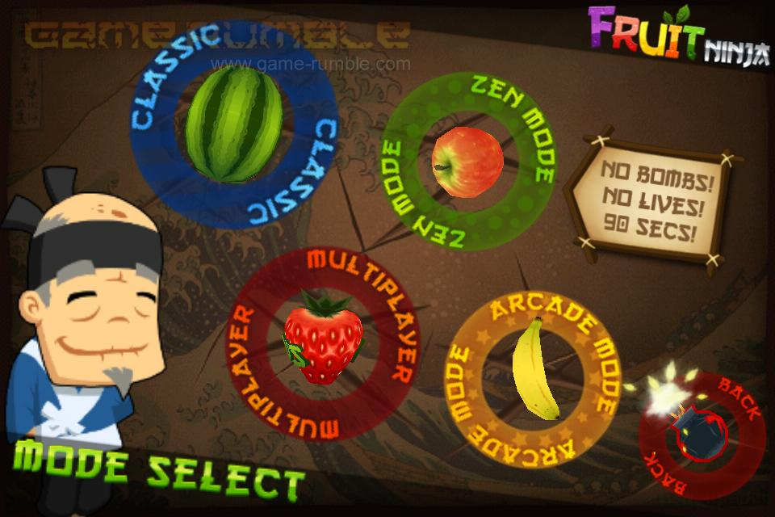

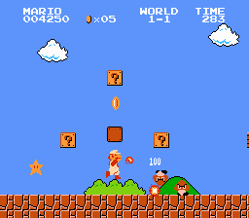
Motivation:
Java Game:
Super Mario
Fruit Ninja

Slide 3
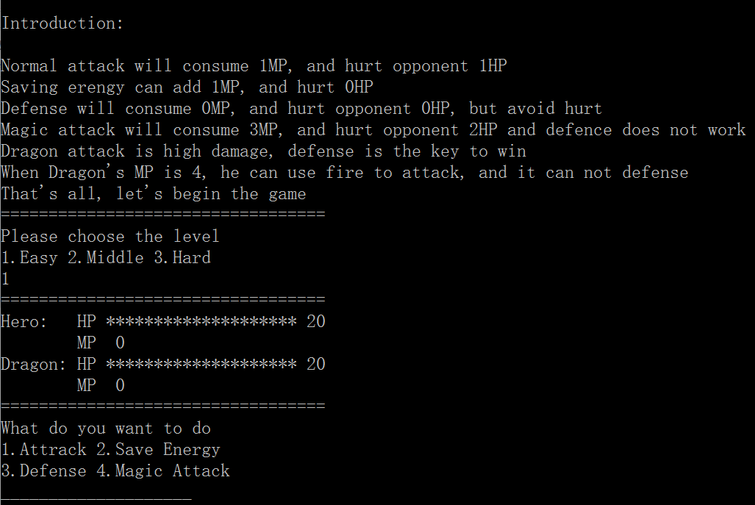
My Game: Hero Fights with Dragon
Text Game
Three Classes
Main Class
Introduction
Other Methods

Slide 4
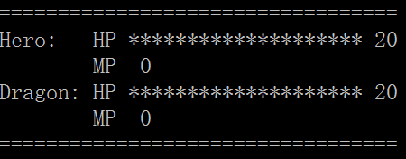
Challenges
How to show HP and MP
Using For loop

Slide 5

The Ending
Thanks For Your Attention!

